Slide 1
Introduction to Decrease and Conquer
An Algorithm Paradigm
By Mohamed Hussein Abo El-Ela
ID: 224175

Slide 2
AGENDA
01
02
03
04
Overview of Decrease and Conquer
Exercise
Analytical Analysis
Game

Slide 3
Introduction to Decrease and Conquer
Decrease and Conquer is a problem-solving technique in computer science where a problem is solved by dividing it into subproblems, solving one part of the problem, and then recursively applying the same approach to the remaining subproblems.
The key idea is to reduce the problem size in a controlled manner until a base case is reached, which can be solved directly.

Slide 4
Example - Lomuto Partition Algorithm
Choose a pivot element from the array. The pivot is used to divide the array into two partitions.
Initialize two pointers, i and j, where i points to the first element of the array, and j iterates through the array from the second element.
Iterate through the array using j. If the element at index j is less than or equal to the pivot, swap the element at index j with the element at index i, and increment i.
Continue this process until j reaches the end of the array.
Swap the pivot element with the element at index i (the position where the pivot belongs).
The array is now partitioned into two halves: elements less than or equal to the pivot on the left and elements greater than the pivot on the right.
Recursively apply the same partitioning process to the left and right subarrays.

Slide 5
Lomuto Partition Algorithm
def quicksort_lomuto(arr, start, end):
if start < end :
# Partition the array and get the pivot index
pivot_index = lomuto_partition(arr, start, end)
# Recursively sort the subarrays on the left and right of the pivot
quicksort_lomuto(arr, start, pivot_index - 1)
quicksort_lomuto(arr, pivot_index + 1, end)
def lomuto_partition(arr, start, end):
pivot = arr[end]
i = start - 1
for j in range(start, end):
if arr[j] <= pivot:
i += 1
arr[i], arr[j] = arr[j], arr[i]
arr[i + 1], arr[end] = arr[end], arr[i + 1]
return i + 1
# Example usage arr = [4, 2, 7, 1, 3] print("Original Array:", arr) quicksort_lomuto(arr, 0, len(arr) - 1) print("Sorted Array:", arr)

Slide 6

Analytical Analysis
T(n)=$T\left(n−1\right)+n$

Slide 7
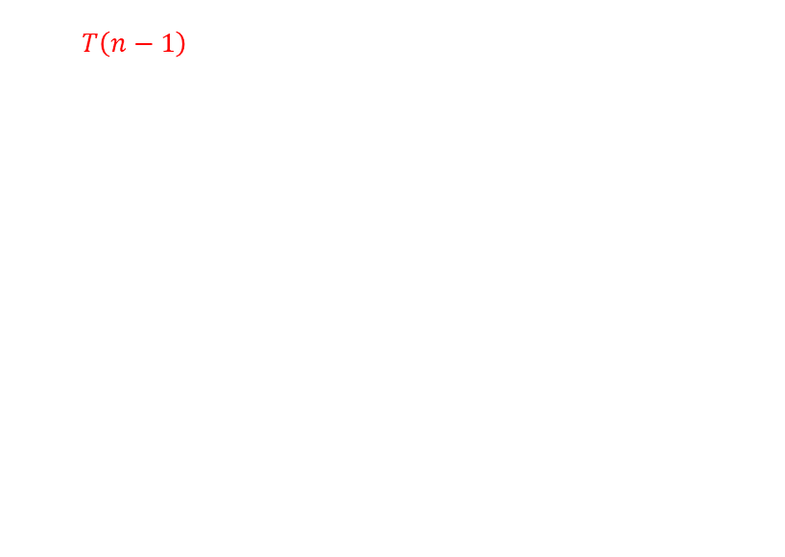
Analytical Analysis
T(n)=$T\left(n−1\right)+n$
T(n-1) = T(n-2) + n-1

Slide 8
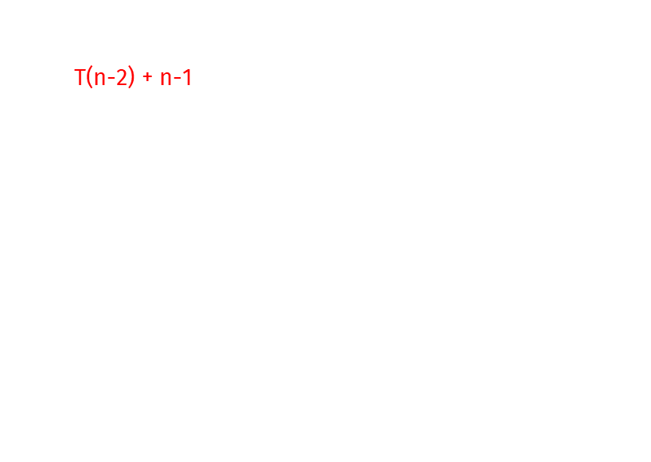
Analytical Analysis
T(n)=$T\left(n−1\right)+n$ T(n) = T(n-2) + n-1 + n
T(n-1) = T(n-2) + n-1

Slide 9

Analytical Analysis
T(n)=$T\left(n−1\right)+n$ T(n) = T(n-2) + n-1 + n
T(n-1) = T(n-2) + n-1
T(n-2) = T(n-3) + n - 2

Slide 10
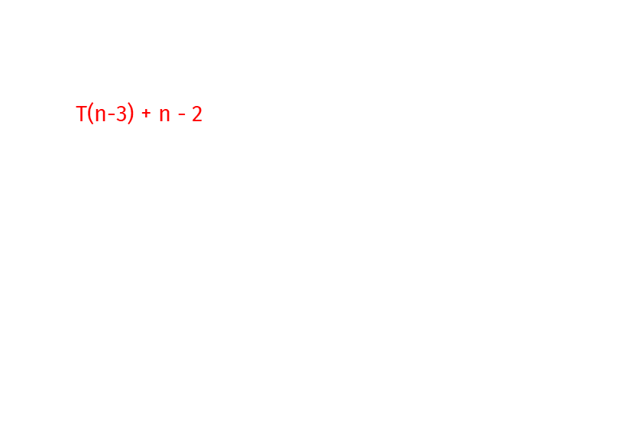
Analytical Analysis
T(n)=$T\left(n−1\right)+n$ T(n) = T(n-2) + n-1 + n
T(n) = T(n-3) + n - 2 + n-1 + n
T(n-1) = T(n-2) + n-1
T(n-2) = T(n-3) + n - 2

Slide 11
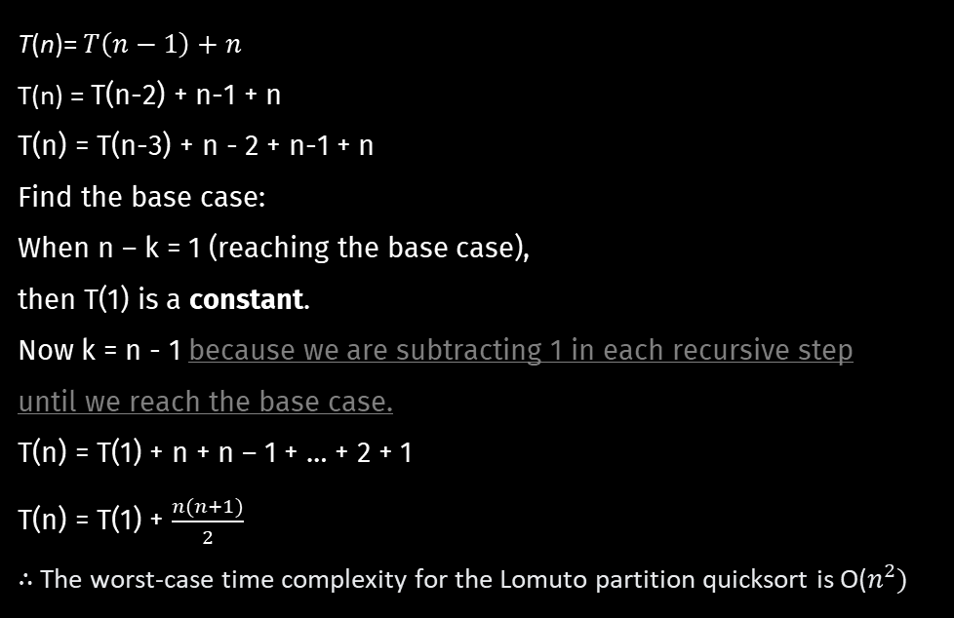
Analytical Analysis
T(n)=$T\left(n−1\right)+n$ T(n) = T(n-2) + n-1 + n
T(n) = T(n-3) + n - 2 + n-1 + n
Find the base case:
When n – k = 1 (reaching the base case),
then T(1) is a constant.
Now k = n - 1 because we are subtracting 1 in each recursive step
until we reach the base case.
T(n) = T(1) + n + n – 1 + … + 2 + 1
T(n) = T(1) + $\frac{n(n+1)}{2}$
∴ The worst-case time complexity for the Lomuto partition quicksort is O($n^{2})$
T(n-1) = T(n-2) + n-1
T(n-2) = T(n-3) + n – 2
We Found Pattern!!!
Then, Generalize

Slide 12
Lets Play a Game!!!

Slide 13

Apologies for not playing the video due to copyright restrictions. Here's the link for your reference:
youtube.com/watch?v=86WSheyr8cM
Or find the link the video description.

Slide 14
The End.

Slide 15
CONCLUSION
In summary, Decrease and Conquer offers a systematic approach to problem-solving by progressively reducing a problem's size until it becomes trivial. This paradigm, exemplified by algorithms like Lomuto Partition in quicksort, enhances efficiency and promotes elegant solutions. Its recursive nature provides a versatile framework for addressing a diverse range of computational challenges in computer science.

Slide 16

THANKS!
Do you have any questions?
mohamed.hussein20@msa.edu.eg
My Portfolio: bit.ly/47uONy4

